Slide 1
Stock Analysis
Here is where your presentation begins

Slide 2
Contents of this template
You can delete this slide when you’re done editing the presentation
Fonts | To view this template correctly in PowerPoint, download and install the fonts we used
Used and alternative resources | An assortment of graphic resources that are suitable for use in this presentation
Thanks slide | You must keep it so that proper credits for our design are given
Colors | All the colors used in this presentation
Icons and infographic resources | These can be used in the template, and their size and color can be edited
Editable presentation theme | You can edit the master slides easily. For more info, click here
For more info: SLIDESGO | BLOG | FAQs
You can visit our sister projects: FREEPIK | FLATICON | STORYSET | WEPIK | VIDEVO

Slide 3
Table of contents
01
02
03
04
05
06
Name of the section
Name of the section
Name of the section
Name of the section
Name of the section
Name of the section

Slide 4

One column
Do you know what helps you make your point clear? Lists like this one:
They’re simple
You can organize your ideas clearly
You’ll never forget to buy milk!
You can replace the image. Just right-click on it and select “Replace image”

Slide 5

01
Name of the section

Slide 6
Two ideas
Mercury
Venus
Mercury is the closest planet to the Sun and the smallest one in the Solar System—it’s only a bit larger than the Moon. The planet’s name has nothing to do with the liquid metal, since Mercury was named after the Roman messenger god
Venus has a beautiful name and is the second planet from the Sun. It’s terribly hot—even hotter than Mercury—and its atmosphere is extremely poisonous. It’s the second-brightest natural object in the night sky after the Moon

Slide 7
Three ideas
Saturn
Saturn is a gas giant and has several rings. It’s composed mostly of hydrogen and helium. This planet was named after the Roman god of wealth and agriculture
Jupiter
Jupiter is a gas giant and the biggest planet in the Solar System. It’s the fourth-brightest object in the night sky and it was named after the Roman god of the skies
Venus
Venus has a beautiful name and is the second planet from the Sun. It’s terribly hot and its atmosphere is poisonous. It’s the second-brightest natural object in the night sky

Slide 8
Four ideas
Mars
Venus
Despite being red, Mars is actually a cold place. It’s full of iron oxide dust, which gives the planet its reddish cast, and it’s made of basalt
Venus has a beautiful name and is the second planet from the Sun. It’s terribly hot and has an extremely poisonous atmosphere
Jupiter
Saturn
Jupiter is a gas giant and the biggest planet in the Solar System. It’s the fourth-brightest object in the night sky
Saturn is a gas giant and has several rings. It’s composed mostly of hydrogen and helium. It’s the sixth planet from the Sun

Slide 9
Six ideas
Mars
Venus
Neptune
Despite being red, Mars is actually a cold place. It’s full of iron oxide dust, which gives the planet its reddish cast
Venus has a beautiful name and is the second planet from the Sun. It’s terribly hot, even hotter than Mercury
Neptune is the farthest planet from the Sun. It’s also the fourth-largest planet by diameter in the Solar System
Earth
Saturn
Jupiter
Earth is the third planet from the Sun and the only one that harbors life in the Solar System. We all live on this planet
Saturn is a gas giant and has rings. It’s composed mostly of hydrogen and helium. It’s the sixth planet from the Sun
Jupiter is a gas giant and the biggest planet in the Solar System. It’s the fourth-brightest object in the night sky

Slide 10
4,498,300,000
Big numbers catch your audience’s attention

Slide 11

A picture is worth a thousand words

Slide 12

Pie chart
8%
47%
Q3
Q1
Venus is very hot
Mars is very cold
28%
17%
Q4
Q2
Earth has life
Mercury is small
Follow the link in the graph to modify its data and then paste the new one here. For more info, click here

Slide 13
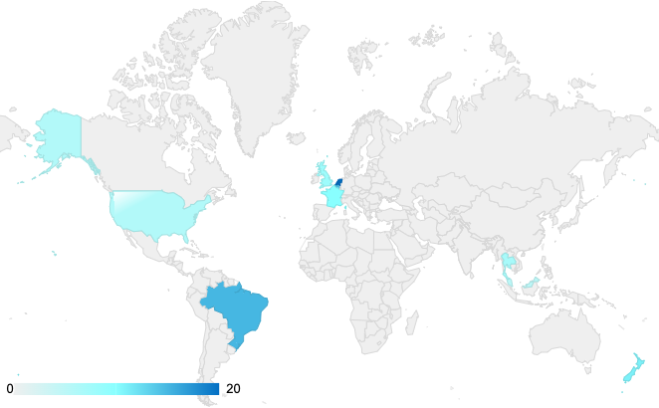
Map
Mercury is the closest planet to the Sun and the smallest of them all
Venus has a beautiful name and is the second planet from the Sun
Mars is full of iron oxide dust, which gives the planet its reddish cast
Follow the link in the graph to modify its data and then paste the new one here. For more info, click here

Slide 14
Table
 | Team A | Team B | Team C | Team D | Team E | Team F
Mercury | XX | XX | XX | XX | XX | XX
Mars | XX | XX | XX | XX | XX | XX
Saturn | XX | XX | XX | XX | XX | XX
Venus | XX | XX | XX | XX | XX | XX
Jupiter | XX | XX | XX | XX | XX | XX
Earth | XX | XX | XX | XX | XX | XX
Moon | XX | XX | XX | XX | XX | XX

Slide 15

Timeline
Mercury is very small
1
7
Mars is made of basalt
Venus is a hot planet
2
6
Jupiter is a gas giant
Saturn has rings
3
4
5
We live on the Earth
Neptune is an ice giant

Slide 16
Target infographic
 | Demographic
Age | 25-50 years old
Gender | Male and female
Occupation | Employees and students
Family Situation | Single and married people
Income | $50,000/year
Behavior
Mercury is the closest planet to the Sun and the smallest one
Venus has a beautiful name and is the second planet from the Sun
Despite being red, Mars is actually a cold place. It’s full of iron oxide dust
Geographic | Region | Area
 | Europe, Asia | Urban

Slide 17
Organizational chart
Sun
CEO
Jupiter
Department Head
Neptune
Department Head
Saturn
Manager
Earth
Manager
Venus
Manager
Mars
Manager
Moon
Employee
Mercury
Employee
Titan
Employee
Triton
Employee
Callisto
Employee

Slide 18
Roadmap infographic
Initiative | J | F | M | A | M | J | J | A | S | O | N | D | Objective
Venus is very hot |  |  |  |  |  |  |  |  |  |  |  |  | Venus is the second planet from the Sun
Earth has life |  |  |  |  |  |  |  |  |  |  |  |  | Earth is the third planet from the Sun
Mars is very cold |  |  |  |  |  |  |  |  |  |  |  |  | Despite being red, Mars is very cold
Jupiter is big |  |  |  |  |  |  |  |  |  |  |  |  | Jupiter doesn’t have a solid surface
Saturn has rings |  |  |  |  |  |  |  |  |  |  |  |  | Saturn is a gas giant and has several rings
Mercury is small |  |  |  |  |  |  |  |  |  |  |  |  | Mercury is the closest planet to the Sun

Slide 19



Photo showcase
You can replace the images on the screen with others. Just right-click on any of them and select “Replace image”

Slide 20
Thanks!
Do you have any questions?
youremail@freepik.com
+34 654 321 432
yourwebsite.com
Please keep this slide for attribution

Slide 21
Alternative resources
Here’s an assortment of alternative resources whose style fits the one of this template:
Vectors
Hand drawn flat design stock market concept
Hand drawn flat design stock market concept

Slide 22
Resources
Did you like the resources on this template? Get them for free at our other websites:
Vectors
Gradient stock market concept
Gradient cryptocurrency concept
Photos
Close up hand typing on calculator
Business concept with calculator close up
Medium shot man talking on phone
Close up hand holding smartphone
Medium shot queer people at work
Close up hand holding clipboard
People at the office during a work day

